Slide 1




INNOVATE. BUILD. IMPACT.
KMC
HACKATHON
2082
JAN-29,2026
TURN YOUR IDEAS INTO REAL-WORLD SOLUTIONS

Slide 2

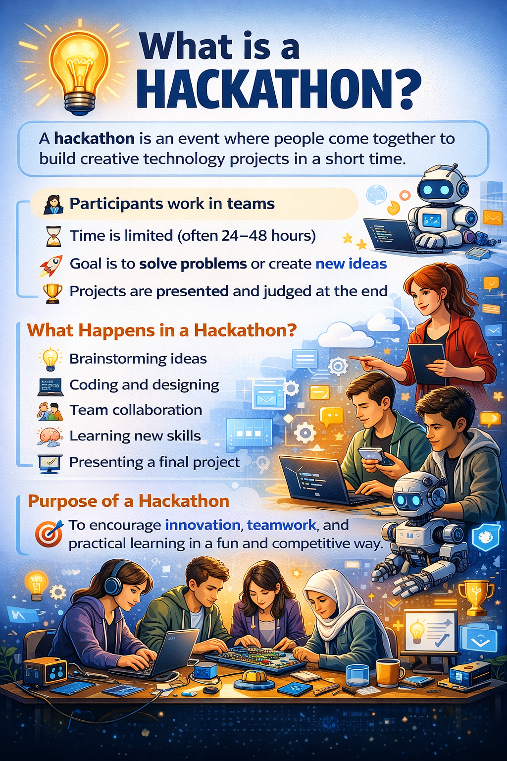

What is a Hackathon?
A TIME-BOUND INNOVATION CHALLENGE
WORK IN TEAMS TO SOLVE REAL-WORLD PROBLEMS
FOCUS ON CREATIVITY, TEAMWORK, AND PRACTICAL SOLUTIONS

Slide 3
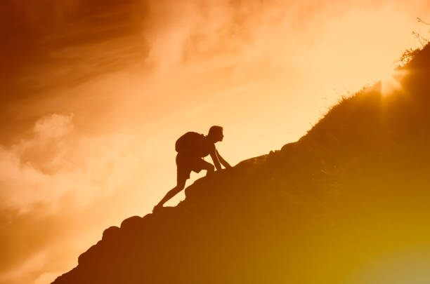
Purpose
of KMC Hackathon
Encourage student innovation
Solve local and community problems
Promote technology for social good
Build coding, design, and presentation skills

Slide 4


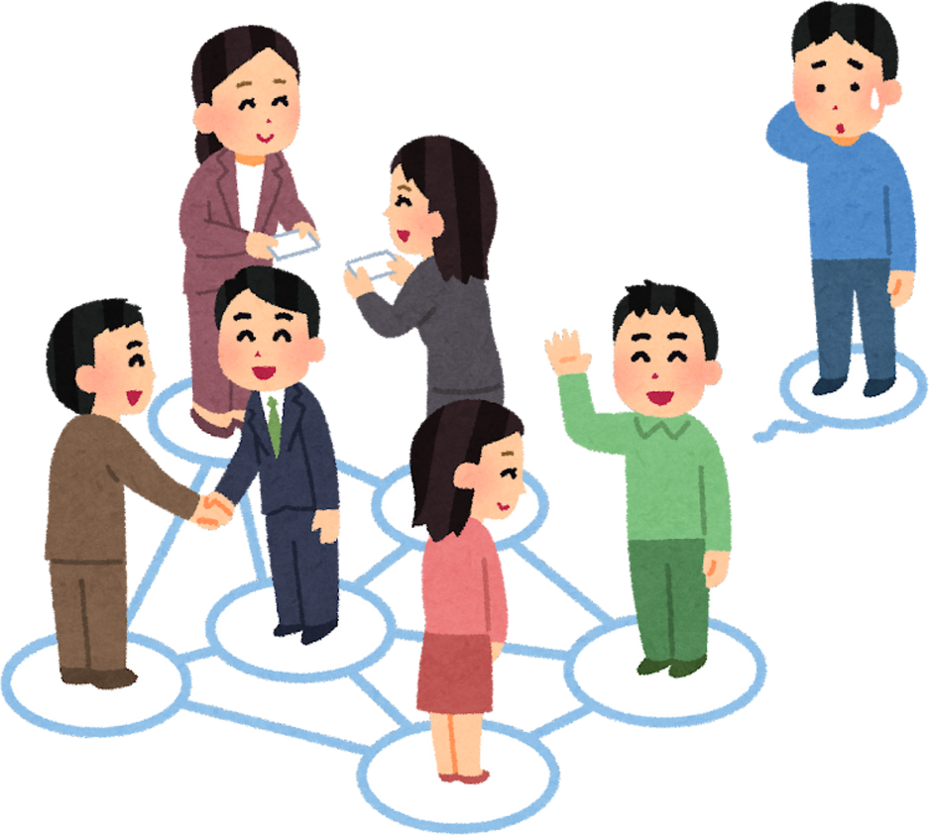
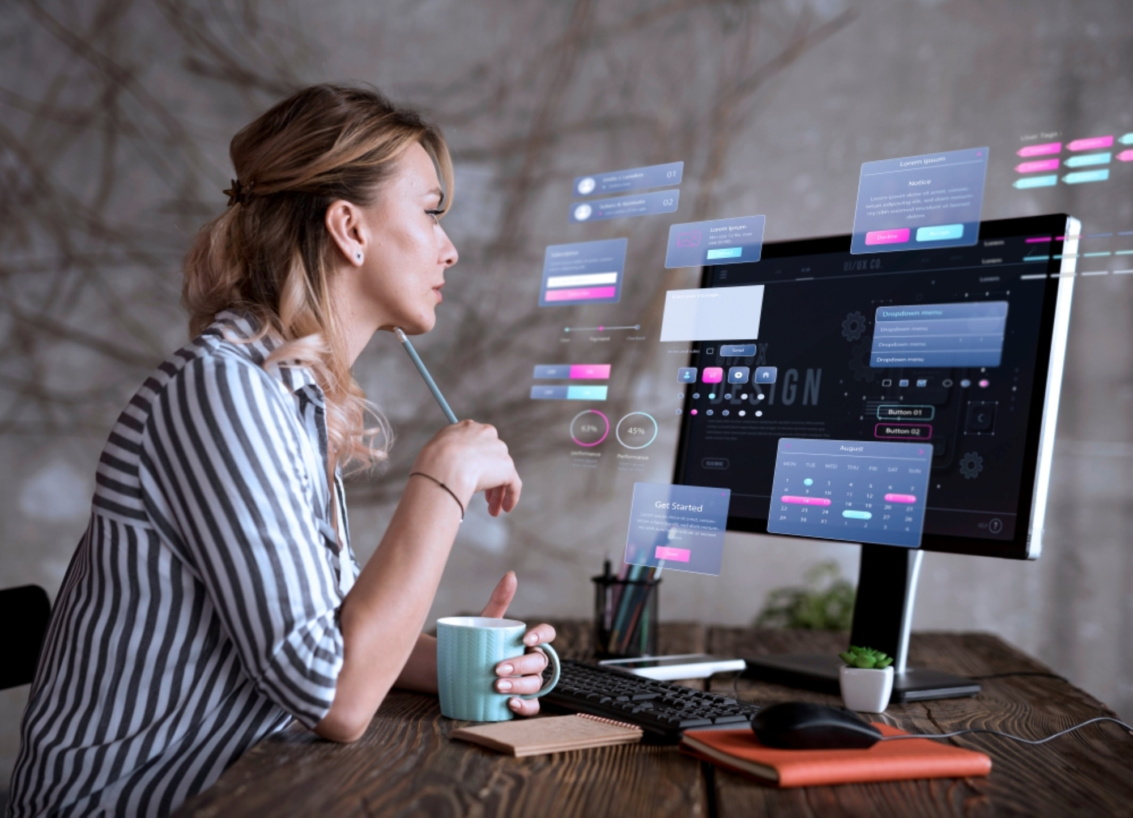
Hackathon Themes
•Health & Wellbeing
•Environment & Sustainability
•Education & Learning
•Smart City / Community Solutions
•Entrepreneurship & Digital Services

Slide 5
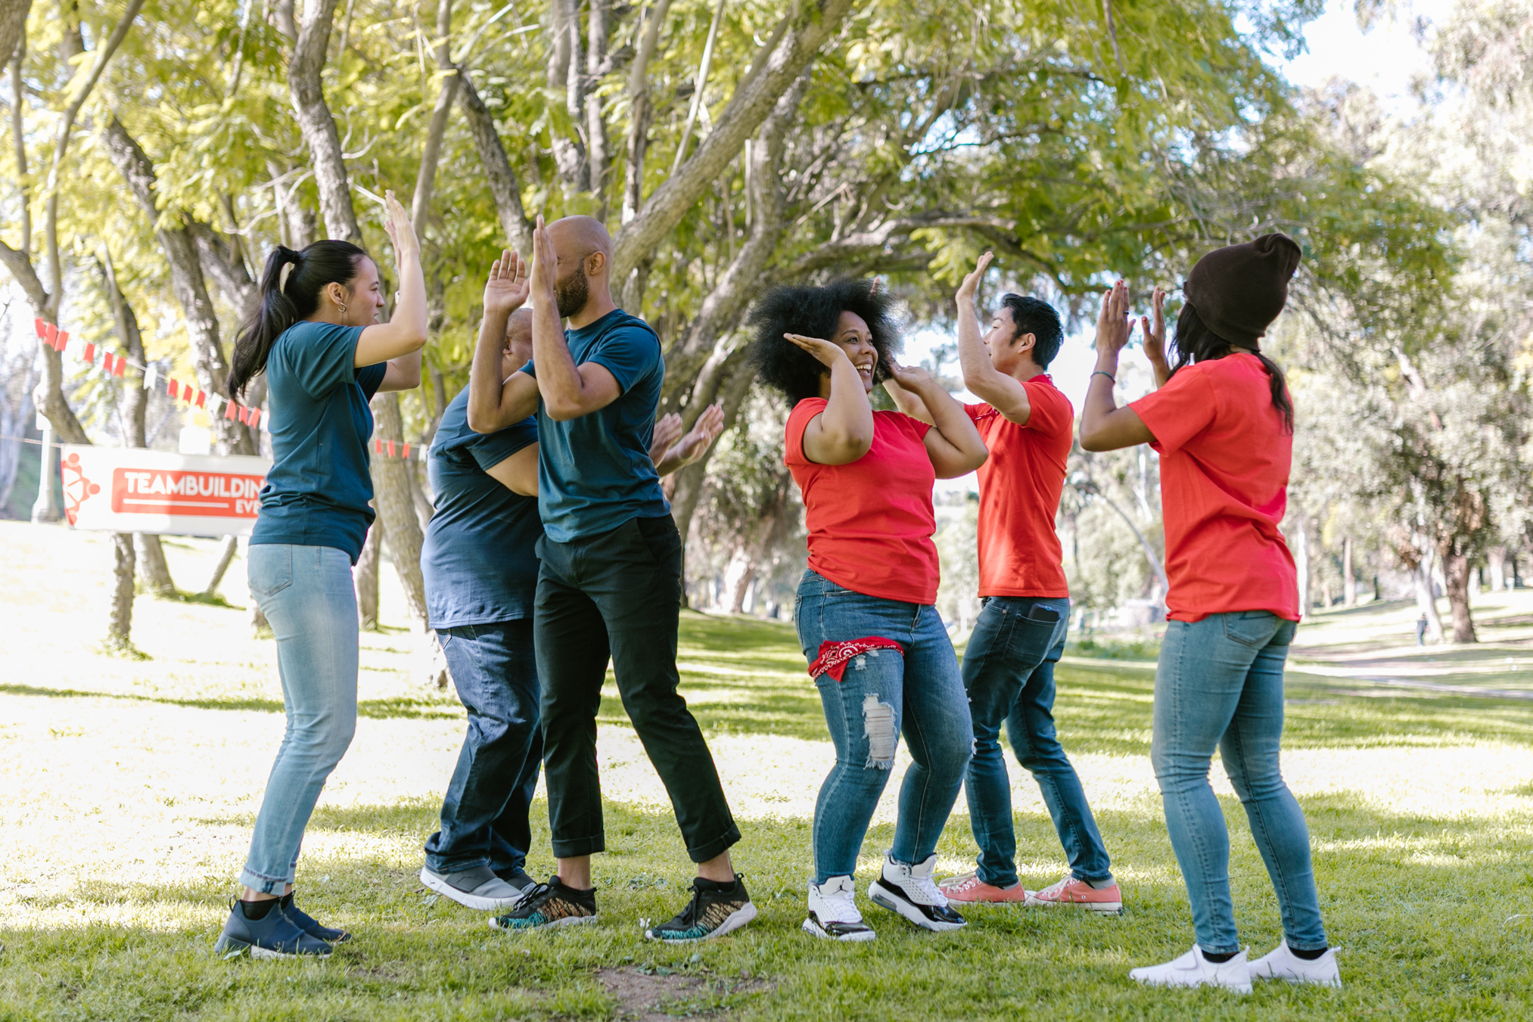
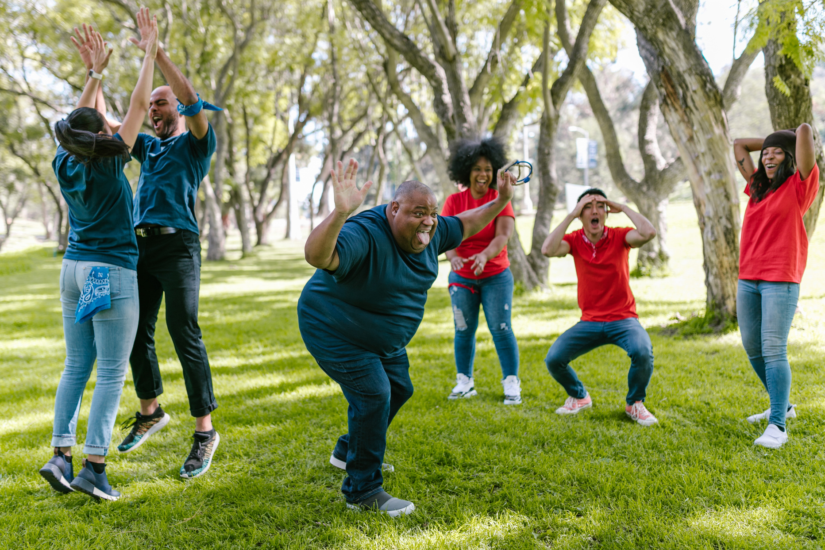
Team Rules
•Each team must have 3–4 members
•Select one team leader
•No team changes after the event starts
•Maintain teamwork and collaboration

Slide 6
Orientation
&
Team-Up
Idea Finalization
&
Mentoring
Development
&
Testing
Final Submission
&
Presentation
1
2
3
4
Beginning
Planning
Creativity
Demonstration
Our story begins with a creative idea and team formation.
Idea planning and training phase, brainstorming and roadmap
Development of a digital solution focused on enhancing creativity.
Development of a digital solution focused on enhancing creativity in children at an early age.

Slide 7
Initial due date: 25th magh
Project name finalization
Problem statement
Solution ideas
Project design idea (wireframe) and workflow diagram
Project timeline
Prepare short report (What, Why, When, How, etc)
Create GitHub repo. and upload your progress.
For Interschool event: we will select participants based on this initial submission
Project Resources and references visit:
https://github.com/santosh312-dev/KMC-Hackathon-1.0-Resources

Slide 8
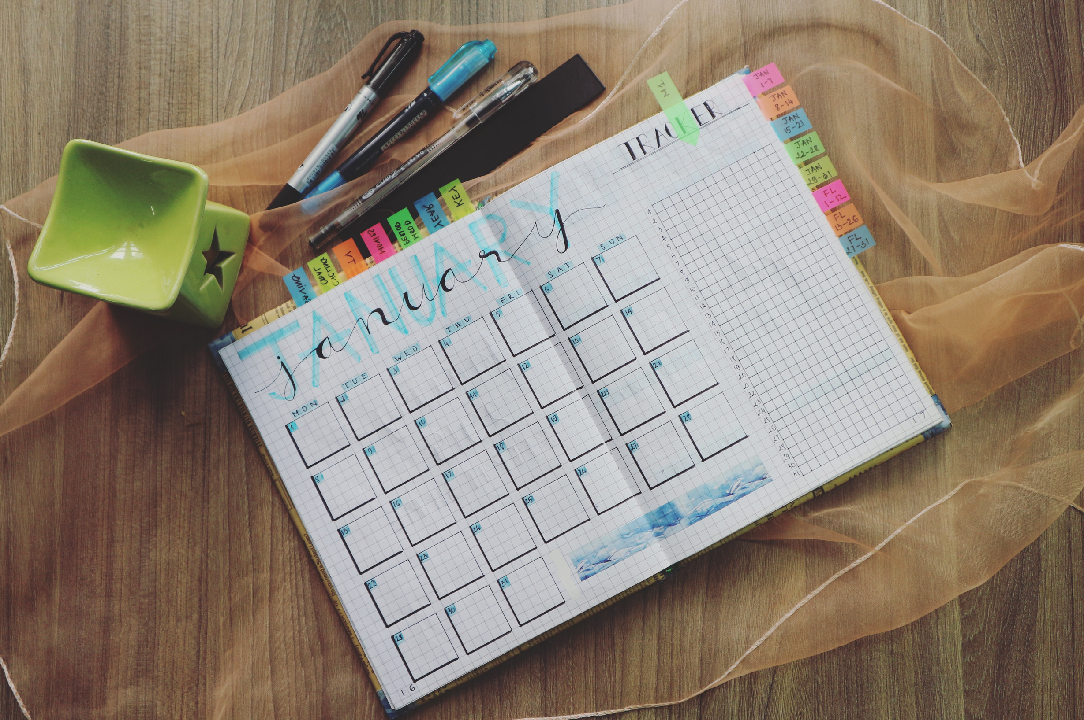
What You Must Do
•PROJECT NAME
•PROBLEM STATEMENT
•SOLUTION DESCRIPTION
•PROTOTYPE / DEMO
•PRESENTATION SLIDES (PPT/PDF)

Slide 9

Judging Criteria
PROBLEM UNDERSTANDING & RELEVANCE
DESIGN & USER EXPERIENCE (UI/UX)
FUNCATIONALITY &LOGICS
CODE QUALITY & GITHUB USAGE
PRESENTATION & COMMUNICATION
CREATIVITY & INNOVATION

Slide 10

Rules & Code of conduct
No plagiarism
No Entertaining Projects
Respect all participants
Use internet for learning, not copying
Follow time limits
Ask mentors for help when needed

Slide 11

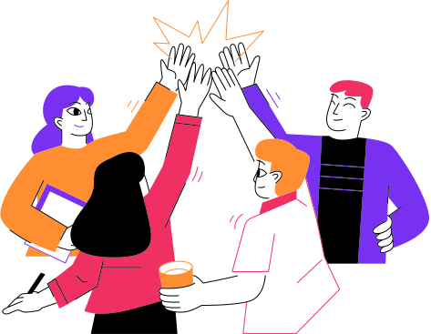


Mentors & Support
•Mentors will help with technical issues
•Get feedback to improve your idea
•Ask questions freely

Slide 12



Final Presentation Format
•Explain the problem
•Describe your solution
•Show a live demo or recorded demo
•Discuss future improvements

Slide 13




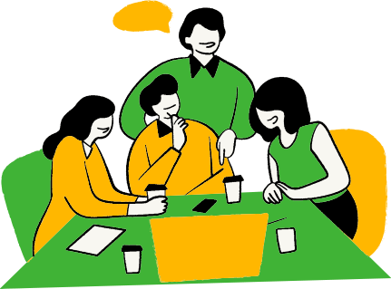





Final Motivation
•Focus on learning and building
•Try bold and creative ideas
•Great innovations start with simple prototypes
•Let’s build something amazing!

Slide 14
Any Questions?

Slide 15

Thank you!
For more information visit Computer Department

